Slide 1






HSS133 – Creativity, Problem Solving & Innovation
“ Built for Developers
Prepared By
18DCS005 | KSHITIJ ANTANI
18DCS006 | KRUNAL BABARIYA
18DCS007 | RUDRA BARAD
18DCS008 | TIRTH BHARATIYA
Group 2

Slide 2
WHAT IS GITHUB ?
Introduced in 2007 as GIT ( Version Control System )
Largest web-based git repository hosting service
Hosting Platform for version control and collaboration
Allows Documentation, Bug Tracking & Tracing, Task Management and Version Control of different Projects

Slide 3

GitHub plays an important role in securing the world’s code—developers, maintainers, researchers, and security teams. On GitHub, development teams everywhere can work together to secure the world’s software supply chain, from fork to finish.

Slide 4

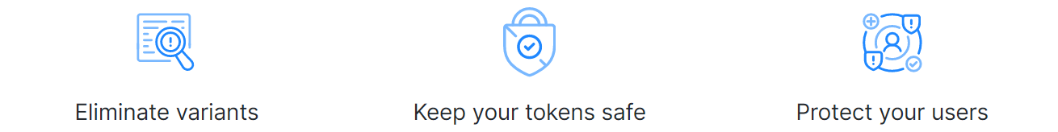
Code review is the surest path to better code, and it’s fundamental to how GitHub works. Built-in review tools make code review an essential part of your team’s process.
Helps in not making the same mistake twice. Helps in preventing Vulnerabilities
Accidentally committed something ? Don’t worry, GitHub will keep you safe
Provides the infrastructure security researchers to responsibly disclose security vulnerabilities.

Slide 5


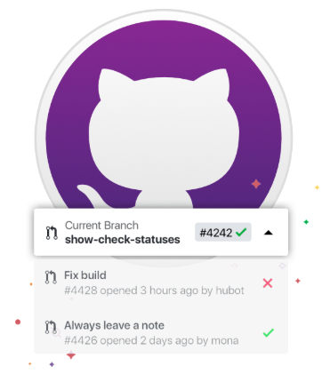

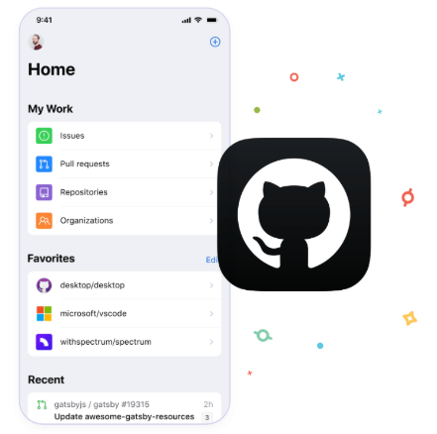



Whether you want to simplify your Git workflow or take GitHub on the go, they’ve got you covered.

Slide 6


There are hundreds of millions of private, public, and open source repositories hosted on GitHub. Every repository is equipped with tools to help us host, version, and release code and documentation.
It helps to keep code in one place and help teams collaborate with the tools they love. With unlimited private repositories for individuals and teams, we can create or import as many projects as we’d like.

Slide 7

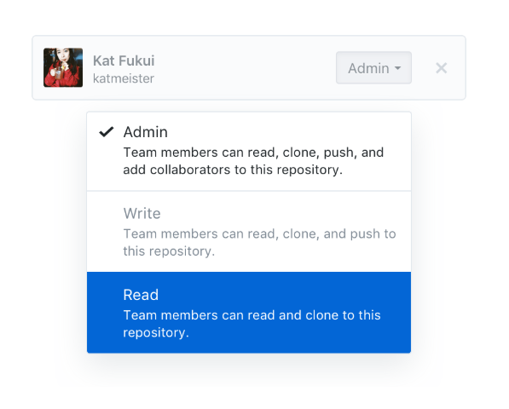
Building software is as much about managing teams and communities as it is about code. Whether we’re on a team of two or two thousand, we’ve got the support our people need.
Manage and grow teams
GitHub teams helps people get organize, level up access with administrative roles, and fine tune your permissions with nested teams.

Slide 8
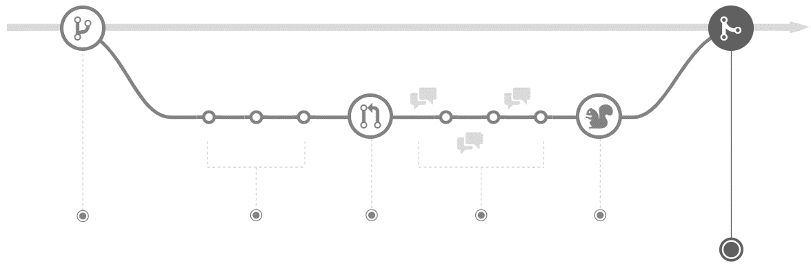
UNDERSTANDING THE GITHUB FLOW
GitHub flow is a lightweight, branch-based workflow that supports teams and projects where deployments are made regularly. This guide explains how and why GitHub flow works
Creating a branch
Adding Commits
Opening a Pull Request
Discussing & Reviewing the code
Deploying
Merging the Project

Slide 9
Statistics
The Expanding Octoverse
+2.8 M
40m + Developers
+2.2 M
44m + Repositories
+1.7 M
87m + Pull Requests
+1.2 M
2019
1.7m + Students Leaned GitHub
2018
2017
This year, we’ve seen that not only do companies use GitHub, they also contribute to open source & take part in the developers community.
Almost 70% of Global companies have made a contribution to open source in the last year.
2016
20XX
20XX
Open Source Contributions

Slide 10



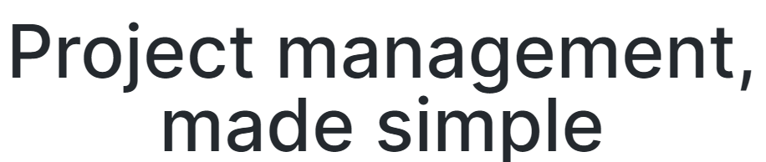
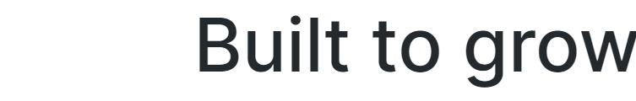
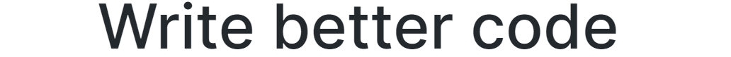
Overview
THANKYOU

